Slide 1
JSON: The Basics

Slide 2
Overview
What is JSON?
Comparisons with XML
Syntax
Data Types
Usage
Live Examples

Slide 3
What is JSON?

Slide 4

JSON is…
A lightweight text based data-interchange format
Completely language independent
Based on a subset of the JavaScript Programming Language
Easy to understand, manipulate and generate

Slide 5

JSON is NOT…
Overly Complex
A “document” format
A markup language
A programming language

Slide 6

Why use JSON?
Straightforward syntax
Easy to create and manipulate
Can be natively parsed in JavaScript using eval()
Supported by all major JavaScript frameworks
Supported by most backend technologies

Slide 7
JSON vs. XML

Slide 8


Much Like XML
Plain text formats
“Self-describing“ (human readable)
Hierarchical (Values can contain lists of objects or values)

Slide 9

Not Like XML
Lighter and faster than XML
JSON uses typed objects. All XML values are type-less strings and must be parsed at runtime.
Less syntax, no semantics
Properties are immediately accessible to JavaScript code

Slide 10

Knocks against JSON
Lack of namespaces
No inherit validation (XML has DTD and templates, but there is JSONlint)
Not extensible
It’s basically just not XML

Slide 11
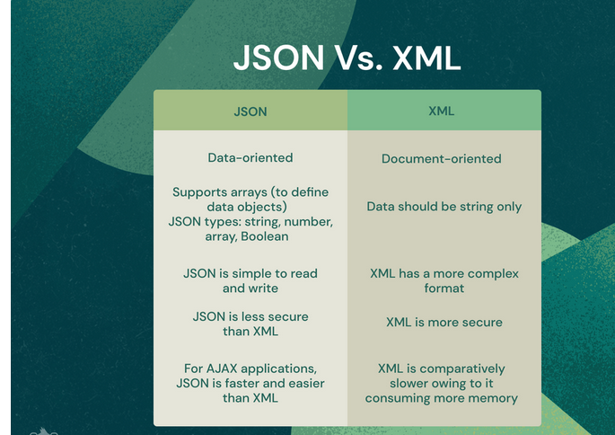
JSON Usage

Slide 13
How & When to use JSON
Transfer data to and from a server
Perform asynchronous data calls without requiring a page refresh
Working with data stores
Compile and save form or user data for local storage

Slide 14








Where is JSON used today?
Anywhere and everywhere!
And many, many more!

Slide 15
Syntax

Slide 16
JSON Object Syntax
Unordered sets of name/value pairs
Begins with { (left brace)
Ends with } (right brace)
Each name is followed by : (colon)
Name/value pairs are separated by , (comma)

Slide 17
JSON Example
var employeeData = {
"employee_id": 1234567,
"name": “Freyan",
"hire_date": "1/1/2021",
"location": "Norwalk, CT",
"consultant": false
};

Slide 18
Arrays in JSON
An ordered collection of values
Begins with [ (left bracket)
Ends with ] (right bracket)
Name/value pairs are separated by , (comma)

Slide 19
JSON Array Example
var employeeData = {
"employee_id": 1236937,
"name": “khyati",
"hire_date": "1/1/2022",
"location": "Norwalk, CT",
"consultant": false,
"random_nums": [ 24,65,12,94 ]
};

Slide 20
Data Types

Slide 21
Data Types: Strings
Sequence of 0 or more Unicode characters
Wrapped in "double quotes“
Backslash escapement

Slide 22
Data Types: Numbers
Integer
Real
Scientific
No octal or hex
No NaN or Infinity – Use null instead.

Slide 23
Data Types: Booleans & Null
Booleans: true or false
Null: A value that specifies nothing or no value.

Slide 24
Data Types: Objects & Arrays
Objects: Unordered key/value pairs wrapped in { }
Arrays: Ordered key/value pairs wrapped in [ ]

Slide 25
Simple Example

Slide 26
Simple Demo
Build a JSON data object in code
Display raw output
Display formatted output
Manipulate via form input

Slide 27
JSON objects
JSON Array of Numbers
[12, 34, 56, 43, 95]
JSON Array of Booleans
[true, true, false, false, true]
JSON Array of Objects
{"employees":[
{"name":"Ram", "email":"ram@gmail.com", "age":23},
{"name":"Shyam", "email":"shyam23@gmail.com", "age":28},
{"name":"John", "email":"john@gmail.com", "age":33},
{"name":"Bob", "email":"bob32@gmail.com", "age":41}
]}

Slide 28
JSON Multidimensional Array
[
[ "a", "b", "c" ],
[ "m", "n", "o" ],
[ "x", "y", "z" ]
]

Slide 29
Java JSON
The json.simple library allows us to read and write JSON data in Java.
we can encode and decode JSON object in java using json.simple library.
The org.json.simple package contains important classes for JSON API.
JSONValue
JSONObject
JSONArray
JsonString
JsonNumber

Slide 30
Encoding JSON in Java
import org.json.simple.JSONObject;
public class JsonExample1{
public static void main(String args[]){
JSONObject obj=new JSONObject();
obj.put("name","sonoo");
obj.put("age",new Integer(27));
obj.put("salary",new Double(600000));
System.out.print(obj);
}}

Slide 31
Java JSON Encode using List
import java.util.ArrayList;
import java.util.List;
import org.json.simple.JSONValue;
public class JsonExample1{
public static void main(String args[]){
List arr = new ArrayList();
arr.add("sonoo");
arr.add(new Integer(27));
arr.add(new Double(600000));
String jsonText = JSONValue.toJSONString(arr);
System.out.print(jsonText);
}}

Slide 32
Java JSON Decode
import org.json.simple.JSONObject;
import org.json.simple.JSONValue;
public class JsonDecodeExample1 {
public static void main(String[] args) {
String s="{\"name\":\"sonoo\",\"salary\":600000.0,\"age\":27}";
Object obj=JSONValue.parse(s);
JSONObject jsonObject = (JSONObject) obj;
String name = (String) jsonObject.get("name");
double salary = (Double) jsonObject.get("salary");
long age = (Long) jsonObject.get("age");
System.out.println(name+" "+salary+" "+age);
}
}

